Slide 1
Design Thinking

Slide 2
What is Design Thinking??
Design Thinking is a problem-solving and innovation methodology that prioritizes a human-centered approach. It emerged as a concept in the field of design but has since been widely adopted across various industries and disciplines. The process encourages a creative and collaborative approach to problem-solving, emphasizing empathy for the end-users or customers.

Slide 3
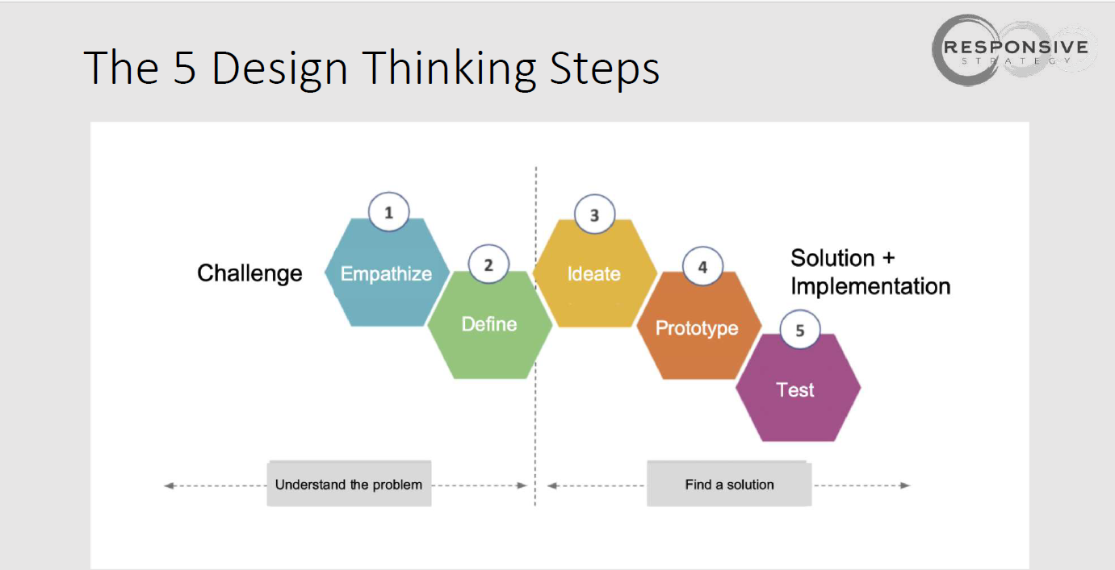

Slide 4
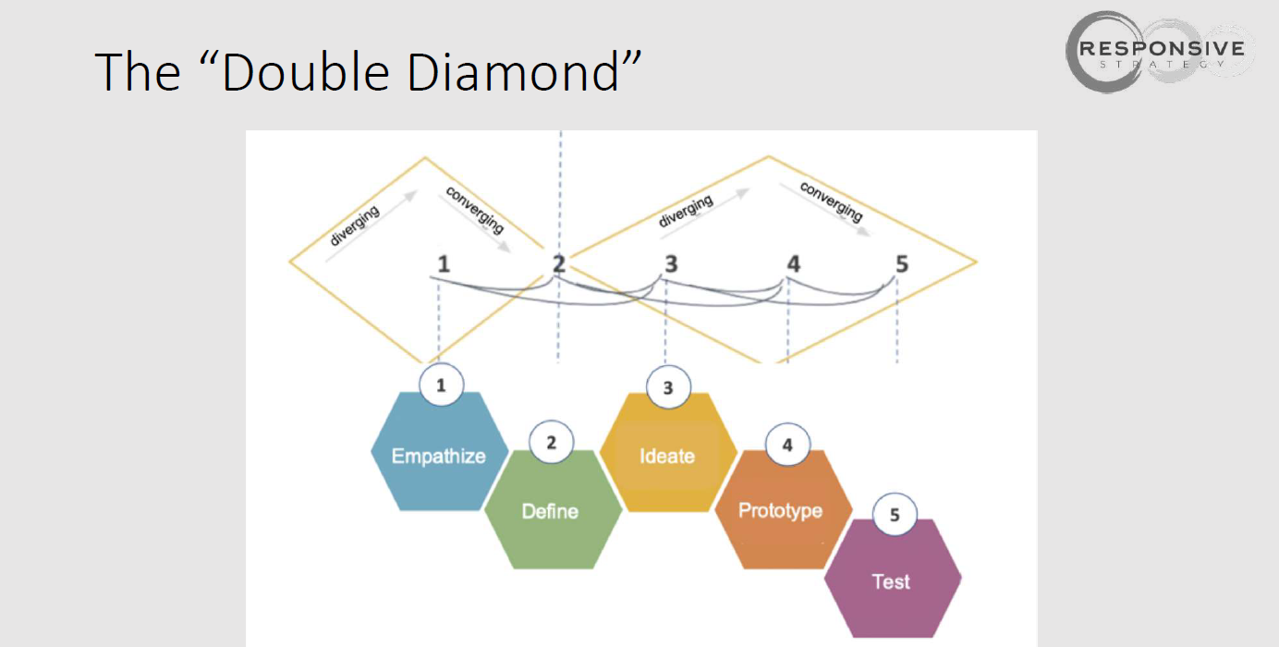

Slide 5
Key Stages in Design Thinking process.
Empathize: Understand the needs, desires, and challenges of the users or stakeholders. This involves active listening, observation, and engaging with the people for whom you are designing.
Define: Clearly articulate the problem or challenge based on the insights gained during the empathize stage. This involves synthesizing information and identifying the core issues that need to be addressed.
Ideate: Generate a wide range of creative and innovative ideas to solve the defined problem. This stage encourages a free-flowing, open-minded, and non-judgmental approach to brainstorming.

Slide 6
Prototype: Develop tangible representations of your ideas. Prototypes can be anything from simple sketches to physical models or interactive digital representations. The goal is to quickly and cheaply test ideas and gather feedback.
Test: Gather feedback on the prototypes from users or stakeholders. This iterative process helps refine and improve the solutions, leading to better alignment with user needs.
Implement: Once a solution has been refined and validated through testing, it can be implemented on a larger scale. This stage may involve scaling up the solution, launching a product, or integrating the solution into existing systems.

Slide 7
One of the key principles of Design Thinking is its iterative nature. Teams often cycle through these stages multiple times, refining and improving their solutions based on ongoing feedback and insights. The methodology is known for fostering a user-centric and collaborative mindset, promoting innovation and the development of solutions that truly address the needs of the end-users.

Slide 8
Basic Principle of design thinking
Way to develop new ideas to challenges
Trial and Error
Team focus
Time boxing
Challenge
Stakeholder focus
Cost effective
Be Agile

Slide 9
How might We?
How might we do something?
How might we solve someone’s need
How might we design the perfect toaster?

Slide 10
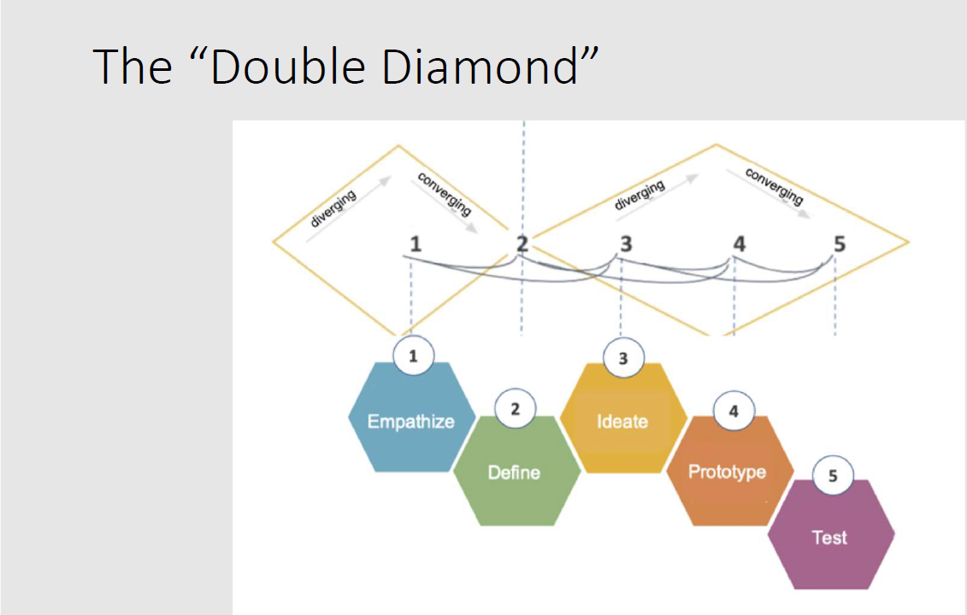

Slide 11
Empathize
Collect Insights
1. Do research
2. Interview stakeholders
3. Immerse yourself
In the Design Thinking process, the "Empathize" phase is the first step and serves as the foundation for creating innovative solutions to complex problems. During this phase, the primary goal is to deeply understand and empathize with the needs, experiences, and perspectives of the people for whom you are designing a product, service, or solution. This phase is crucial because it helps designers gain insights into the human aspects of the problem they are trying to solve.

Slide 12
Here are key elements and activities involved in the Empathize phase:
User Research: Conduct in-depth research to gather information about the end-users, customers, or stakeholders who will be impacted by the solution. This research may include interviews, surveys, observations, and data analysis to uncover their pain points, desires, and behaviors.
Persona Development: Create personas or user profiles that represent the characteristics and needs of different user groups. Personas help design teams have a clearer picture of their target audience and their specific needs.
Empathy Mapping: Visualize the user's experience by creating empathy maps. These maps help in understanding what users think, feel, say, and do, as well as identifying their pain points and aspirations.
Immersion and Observation: Immerse yourself in the user's environment whenever possible. This might involve shadowing users, observing their daily routines, or experiencing their challenges firsthand to gain a deeper understanding.

Slide 13
Empathetic Listening: Actively listen to the stories, concerns, and insights of users without judgment. Encourage them to share their thoughts and feelings openly.
Synthesis: After collecting a wealth of data, synthesize the information to identify common patterns, themes, and insights. This process helps in distilling the most critical issues and opportunities.
Define the Problem: Based on the insights gained during the Empathize phase, define the core problem or challenge you need to address. This problem statement will guide the subsequent phases of the Design Thinking process.
Build Empathy: Share the insights and stories you've gathered with your team to build collective empathy. This helps everyone involved in the design process to connect emotionally with the end-users.

Slide 14
The Empathize phase is all about stepping into the shoes of the people you're designing for, setting aside assumptions, and genuinely understanding their needs and experiences.
This deep understanding forms the basis for the ideation, prototyping, and testing phases that follow in the Design Thinking process, ultimately leading to innovative and human-centered solutions.

Slide 15
Define Phase
In the context of Design Thinking, the "Define" phase is the second step of the overall design process, following the "Empathize" phase and preceding the "Ideate," "Prototype," and "Test" phases.
This phase plays a crucial role in understanding and framing the design challenge or problem that needs to be addressed.
The "Define" phase in Design Thinking is a crucial step where the initial observations gathered during the "Empathize" phase are synthesized into a clear and actionable problem statement. This phase is about bringing clarity and focus to the design space.

Slide 16
The key activities and goals of the "Define" phase include:
Data Analysis: Teams analyze the data and observations collected from research to gain insights into user needs and behaviors.
Point of View (POV): A user-centered problem statement is developed. This POV is a concise summary of your user and their needs, which drives the design process.
Reframing the Problem: The problem is reframed in a way that is actionable for the design team. It's about translating insights into opportunities for design.
Creating User Personas: Based on research, fictitious characters are created to represent different user types. These personas help in keeping the team focused on user-centered design.

Slide 17
Identifying User Needs: The specific needs, pains, and gains of the user are identified and prioritized.
Problem Statement: Crafting a clear and concise problem statement that guides the rest of the design process. This statement should be broad enough to allow for creative freedom but narrow enough to be manageable.
The Define phase sets the stage for ideation. By clearly understanding the problem, teams can generate solutions that are both innovative and directly targeted at solving real user needs.
This phase ensures that the design team is not just creating a solution for its sake but is solving the right problem.

Slide 18
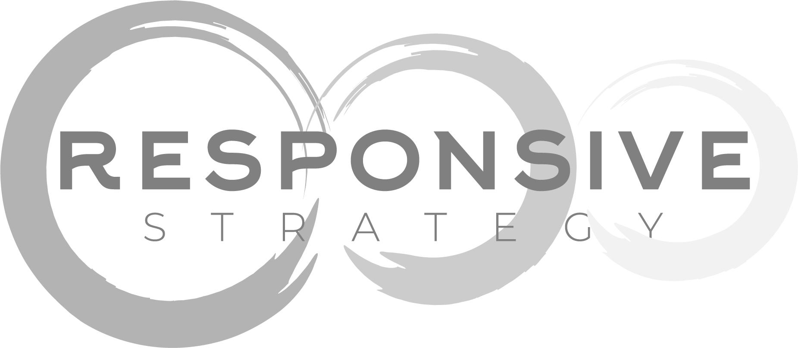
Define Template
What did you find out?
Take a point of view:
Wishes and objects of your „persona“:
What does s/he need?
I have met
…...................................................
(Your name for “persona”)
I found out that s/he
….........................................................
…........................................................
(Feelings, motivations, insights etc)
I can help her/him through
….........................................................
(What does he/she really need?)
Insights:
What are his/her feeling and motivations? What did you hear between the lines?

Slide 19
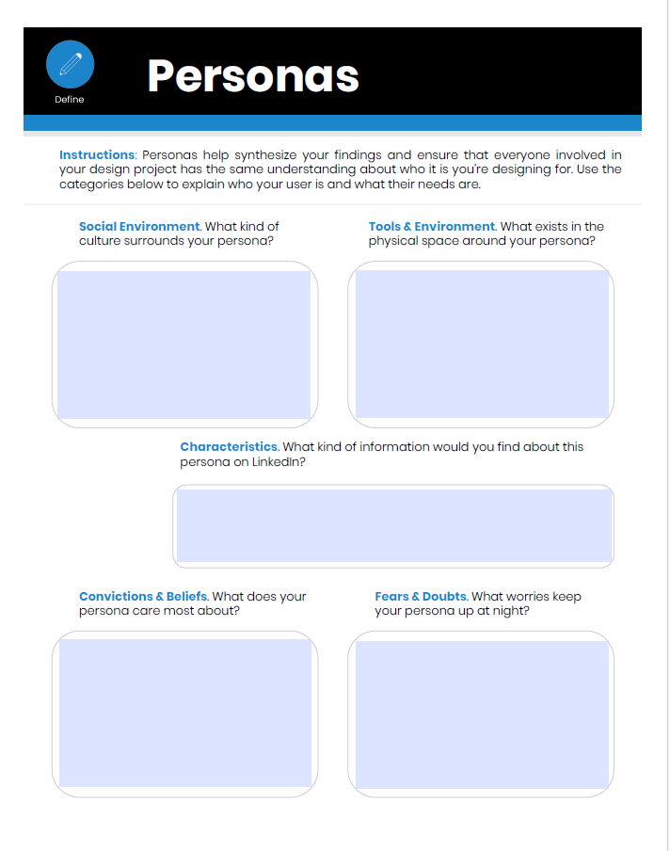

Slide 20
Ideate Phase
The ideate phase is a crucial step in the Design Thinking process. It typically follows the empathize and define phases and precedes the prototype and test phases.
During the ideate phase, the goal is to generate a wide range of creative and innovative ideas to address the problem or challenge identified in the earlier stages.

Slide 21
The "Ideate" phase in Design Thinking is a crucial step where designers brainstorm a wide range of creative ideas to address the challenge they're working on.
This phase is characterized by its emphasis on quantity over quality, encouraging participants to generate a diverse array of ideas without immediately evaluating or critiquing them.
The goal is to expand the solution space and think outside the box, often using methods like mind mapping, sketching, and various brainstorming techniques.
The focus is on fostering creative and unconventional thinking to uncover innovative solutions to the problem at hand.
This phase is typically collaborative, with team members building on each other's ideas to explore as many possibilities as possible.

Slide 22
Here's a breakdown of the ideate phase in Design Thinking:
Divergent Thinking: Ideation encourages participants to think broadly and generate as many ideas as possible without judgment or criticism. The emphasis is on quantity over quality at this stage.
Brainstorming: One common technique used during ideation is brainstorming sessions. These sessions bring together a diverse group of individuals who contribute their ideas freely and build upon each other's thoughts.
Idea Generation Tools: Facilitators may employ various creativity and idea generation tools, such as mind mapping, brainstorming exercises, analogies, metaphors, and role-playing, to stimulate creative thinking.
Encouraging Wild Ideas: Participants are encouraged to think "outside the box" and come up with unconventional and even seemingly impractical ideas. Sometimes, these wild ideas can lead to innovative solutions.

Slide 23
Building on Others' Ideas: Collaboration is key during ideation. Participants should actively listen to each other's ideas, build upon them, and combine concepts to create new possibilities.
Visualizing Ideas: Sketching, diagramming, or using other visual aids can help participants communicate and refine their ideas. Visual representations often make concepts more tangible and easier to understand.
Affinity Mapping: After generating a significant number of ideas, participants can cluster related concepts and identify patterns to make sense of the diverse ideas generated during the ideation phase.
Prioritization: Once a range of ideas has been generated, the next step is to prioritize and select the most promising ones. Criteria for selection may include feasibility, impact, alignment with user needs, and alignment with the project's goals.

Slide 24
Idea Selection: Teams may vote on the ideas they find most promising or use other decision-making methods to narrow down the options.
Concept Development: Selected ideas are then developed further, adding more detail and fleshing out the concepts to create a clearer vision of potential solutions.
The ideate phase is essential because it provides the raw material for creating prototypes in the next phase of the Design Thinking process. By encouraging diverse and creative thinking during ideation, teams can increase the chances of developing innovative solutions that address the problem at hand effectively.

Slide 25
Prototype phase
In Design Thinking, the prototype phase is a critical stage in the iterative problem-solving process.
It involves creating tangible representations of your ideas and concepts to test and refine them.
This phase typically follows the empathize, define, and ideate phases and precedes the test phase.

Slide 26
Here's an overview of what the prototype phase entails:
Define the prototype's purpose: Start by clarifying the specific goals and objectives of your prototype. What are you trying to learn or validate through the prototype? What aspects of your design or solution do you want to test?
Select the appropriate level of fidelity: Prototypes can vary in fidelity, ranging from low-fidelity sketches or paper mock-ups to high-fidelity, functional prototypes. The level of fidelity you choose depends on the questions you want to answer and the resources available. Low-fidelity prototypes are quicker and cheaper to create but may not provide as much realism.
Create the prototype: Build a representation of your design idea using the chosen materials and tools. This could involve sketching, 3D modeling, digital wireframes, or even physical mock-ups, depending on the nature of your project.
Test and gather feedback: The primary purpose of the prototype phase is to gain valuable insights through user testing. Engage with potential users or stakeholders and have them interact with the prototype. Observe their reactions, gather feedback, and note any pain points, insights, or surprises.

Slide 27
Iterate and refine: Based on the feedback received during testing, make iterative improvements to your prototype. This might involve refining the design, adjusting features, or changing the overall concept. Repeat the testing and refinement process as necessary until you've addressed the identified issues and improved the design.
Prepare for the test phase: Once you've iterated and refined your prototype, you're ready to move on to the test phase, where you evaluate the final design and gather additional feedback. The insights gained from prototype testing inform the development of the final solution.

Slide 28
The prototype phase is a fundamental component of Design Thinking as it allows designers and teams to learn from real-world interactions and validate their ideas before committing to full-scale production or development.
It promotes a user-centered approach by emphasizing the importance of user feedback in shaping the final solution.
Iteration and refinement during this phase help ensure that the eventual product or service meets user needs and expectations.

Slide 29
Test Phase
The test phase in Design Thinking is a crucial step in the iterative design process.
It comes after the ideation and prototyping phases and serves as a way to gather feedback and insights from users or stakeholders to refine and improve the design solution before final implementation.
The primary goal of the test phase is to validate the ideas and prototypes created earlier in the process.
This phase involves real-world testing with users to gather feedback, refine the solutions, and ensure they effectively meet the users' needs and solve the identified problem

Slide 30
Here are some key aspects of the test phase in Design Thinking:
Prototype Testing: During this phase, the prototypes developed in the previous phase are tested with real users or stakeholders. These prototypes can range from low-fidelity sketches to high-fidelity mockups or functional prototypes, depending on the project's progress.
User Feedback: The focus is on gathering feedback and insights from the target audience or end-users. This feedback can help uncover potential issues, validate assumptions, and identify areas for improvement.
Iteration: Based on the feedback received, the design team can make necessary adjustments and refinements to the design solution. This iterative process allows for continuous improvement and refinement of the solution.

Slide 31
Testing Methods: Design Thinking encourages the use of various testing methods, such as usability testing, user interviews, surveys, observations, and A/B testing, to gain a deeper understanding of user preferences and pain points.
Empathy and Understanding: The test phase reinforces the empathetic approach of Design Thinking, as it allows designers to better understand users' needs, desires, and behaviors.
Quick and Inexpensive Testing: Design Thinking promotes quick and low-cost testing to avoid investing heavily in a solution that might not meet user needs. This approach allows for flexibility in exploring different design directions.
Multiple Rounds of Testing: It's common to conduct several rounds of testing and iteration to refine the design and ensure it aligns with the users' expectations and requirements.

Slide 32
Failure as a Learning Opportunity: In Design Thinking, failure is seen as a valuable source of learning. If a prototype does not meet users' needs or expectations, it provides insights that can lead to better solutions.
Collaboration: Testing involves cross-functional collaboration, with designers, engineers, marketers, and other stakeholders working together to evaluate and refine the design.
Continuous Feedback Loop: The test phase is not a one-time event; it's part of an ongoing feedback loop that helps ensure that the final design solution is well-informed and user-centered.

Slide 33
Once the test phase has been completed, and the design solution has been refined based on user feedback and insights, the design team can proceed to the implementation phase, where the final product or service is developed and launched.
Design Thinking emphasizes a human-centric and iterative approach, with testing playing a pivotal role in creating innovative and user-friendly solutions.

Slide 34
Empathy Maps
An empathy map is a collaborative tool commonly used in the fields of user experience (UX) design, product management, and service design. It serves as a visual aid that helps teams to gain deeper insight into their customers' or users' needs and experiences. The empathy map is typically divided into sections to categorize different aspects of the user's experience.
Empathy maps are a visual tool used in design thinking and user-centered design processes to help teams better understand and empathize with their target users or customers. They are typically used during the research and ideation stages of a project to gather insights and create a shared understanding of the users' thoughts, feelings, and behaviors

Slide 35
Here's a breakdown of the typical sections in an empathy map:
Think and Feel: This section explores what the user is thinking and feeling while experiencing a service or using a product. It's about understanding the user's emotional and psychological responses.
Hear: This part focuses on what the user might hear while engaging with a product or service. It includes external influences like advice from friends, family, or colleagues, as well as things they might hear in their environment.
See: In this section, you consider what the user sees in their environment while using the product or service. It includes their physical environment, their social situation, and what they see others doing.
Say and Do: This part examines the user's behaviors and actions. It's about understanding how they interact with the product or service and what they might say about it to others.
Pain Points: Here, you identify what frustrates or challenges the user. These are the problems or obstacles they face in relation to the product or service.
Gains: This section is about understanding what the user hopes to gain from the product or service. It includes their goals, needs, and desires.

Slide 36
Empathy Map

Slide 37
To create an empathy map, you typically conduct research through methods like interviews, surveys, observations, or user testing.
Then, you collect data related to what users say, think, feel, and do in relation to your project or problem space.
Once you have gathered enough insights, you can create a visual representation of the empathy map, with each session containing key information and quotes that reflect the user's perspective.
Empathy maps are valuable because they help design teams develop a deeper understanding of their users, which in turn can lead to more effective and user-centered solutions.
They provide a concise and visual way to communicate user insights and serve as a reference point throughout the design process, ensuring that the team remains focused on meeting user needs and expectations.

Slide 38
Empathy maps are typically created in a workshop setting with team members contributing insights and observations.
The map is usually drawn on a large paper or whiteboard and divided into these sections, with post-it notes or markers used to add information to each category.
The goal of an empathy map is to build a shared understanding of the user's world and to create a user-centric perspective for decision-making in the design and development process.

Slide 39
Journey Maps
Journey maps, also known as customer journey maps or user journey maps, are visual representations that illustrate the experiences and interactions a customer or user has with a product, service, or organization over a specific period. These maps are widely used in various fields such as marketing, design, customer experience management, and product development to understand, analyze, and improve the user or customer's journey.

Slide 40
Here are some key aspects of journey maps:
Stages: Journey maps typically divide the customer/user journey into different stages, such as awareness, consideration, purchase, onboarding, usage, and post-purchase support. The specific stages may vary depending on the context and the goals of creating the map.
Touchpoints: Journey maps identify touchpoints, which are the points of interaction between the customer/user and the product or service. These touchpoints can be physical (e.g., a retail store), digital (e.g., a website or app), or human (e.g., customer support).
Customer/User Actions: Journey maps detail the actions, emotions, and thoughts of the customer or user at each stage and touchpoint. This helps in understanding their needs, pain points, and motivations.

Slide 41
Emotions and Pain Points: A crucial aspect of journey maps is capturing the emotions and pain points experienced by the customer/user throughout their journey. This information is essential for improving the overall user experience.
Opportunities for Improvement: Journey maps highlight areas where the customer or user experience can be enhanced. Identifying pain points and areas of friction allows organizations to make strategic improvements.
Multiple Perspectives: Depending on the purpose of the map, it can represent the journey from the perspective of different user personas, customer segments, or other relevant stakeholders.
Visualization: Journey maps are typically presented visually, often in the form of diagrams or infographics. Visualizing the customer journey makes it easier for teams to grasp and act upon the insights.

Slide 42
Creating a journey map involves several steps, including research, data collection, interviews with customers/users, and collaboration among cross-functional teams.
The end result is a comprehensive view of the user's experience, which can be used to drive improvements in products, services, and processes.
Journey maps are versatile tools and can be adapted to suit various industries and purposes, such as improving website usability, optimizing the customer support process, enhancing the user interface of a mobile app, or refining the overall customer experience in a retail environment.

Slide 43
Creating a customer journey map can be done using various tools and formats, including pen and paper, digital design software, or specialized journey mapping software. Here's a simple textual representation of a customer journey map for a hypothetical e-commerce website:
Customer Journey Map: Online Purchase
Stage 1: Awareness
Customer learns about the e-commerce website through social media ads.
Stage 2: Consideration
Customer visits the website.
Customer browses product categories.
Customer reads product reviews.
Customer adds items to the shopping cart.

Slide 44
Stage 3: Purchase
Customer proceeds to checkout.
Customer enters shipping and payment information.
Customer reviews the order.
Customer completes the purchase.
Stage 4: Post-Purchase
Customer receives a confirmation email.
Customer waits for order delivery.
Customer receives the order.
Customer is satisfied with the product quality.

Slide 45
Key Touchpoints:
Website landing page
Product pages
Shopping cart
Checkout process
Confirmation email
Order delivery

Slide 46
Emotions and Thoughts:
Awareness: Curious and interested
Consideration: Comparing options, seeking reviews
Purchase: Slightly anxious about payment security
Post-Purchase: Excited, anxious about delivery
Pain Points:
Slow website loading
Complex checkout process
Concerns about product quality
Unclear shipping times

Slide 47
Opportunities for Improvement:
Optimize website speed.
Simplify checkout process.
Provide detailed product information.
Offer transparent shipping estimates.
This is a simplified textual representation of a customer journey map, but in practice, you might create a visual map that uses graphics, icons, and more detailed descriptions. Visual representations can be more engaging and easier to understand for cross-functional teams and stakeholders.

Slide 48
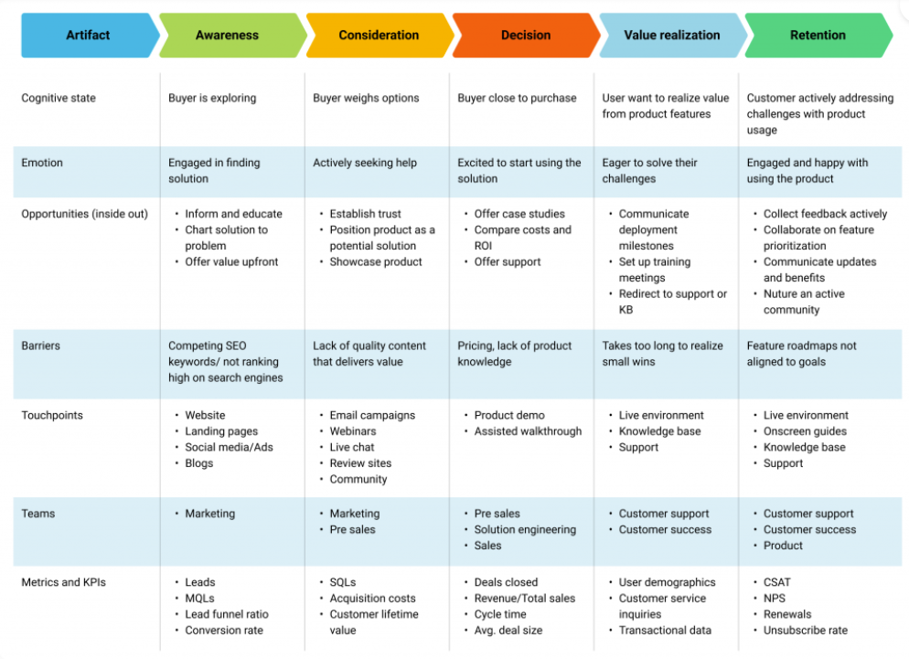

Slide 49
Storyboards
Storyboards are a visual tool used in various creative industries, such as film, animation, video games, and advertising, to plan and visualize the sequence of events or shots in a project. They serve as a visual script or blueprint for a project, helping creators and collaborators to understand and communicate their ideas effectively.
Creating a storyboard for a design context involves visually narrating a sequence of events or processes, typically in the context of product design, user experience (UX) design, or similar fields.

Slide 50
Here's a breakdown of what storyboards are and how they are used:
Visual Representation: Storyboards are a series of drawings, sketches, or images that represent key scenes, shots, or moments in a project. Each frame or panel typically includes visual elements like characters, objects, backgrounds, and any essential details.
Sequence and Timing: Storyboards provide a chronological arrangement of scenes or shots, allowing creators to plan the flow of a story or project. They help establish the pacing, timing, and overall structure of the narrative.
Communication: Storyboards are a crucial tool for communication among team members, including directors, writers, designers, and cinematographers. They enable everyone to understand and visualize the director's vision or the creative concept.
Visual Reference: Storyboards serve as a reference during the production process. They help ensure that everyone involved in the project is on the same page regarding the intended visuals, camera angles, and compositions.

Slide 51
Problem-Solving: Storyboards can highlight potential issues or challenges in a project's design or execution early in the process. This allows for adjustments and problem-solving before the actual production begins.
Cost Estimation: In industries like film and advertising, storyboards can help estimate production costs by identifying the number of shots, locations, and visual effects required.
Storyboarding Tools: Storyboard artists and creators often use various tools to create storyboards, including paper and pencil, digital drawing software, or specialized storyboard software. Digital tools offer the advantage of easy editing and sharing.
Storyboarding Process: The process of creating storyboards typically involves brainstorming, sketching, refining, and finalizing the frames. Depending on the complexity of the project, multiple iterations may be necessary to achieve the desired result.
Storyboard Types: There are different types of storyboards, depending on the medium and the purpose. Some common types include storyboard thumbnails, animatics (animated storyboards), and vertical or horizontal layouts.

Slide 52
Overall, storyboards are a versatile and essential tool for planning and visualizing creative projects, helping creators and teams bring their ideas to life with clarity and coherence. They are an integral part of the pre-production phase in many creative industries, guiding the subsequent stages of production and post-production

Slide 53
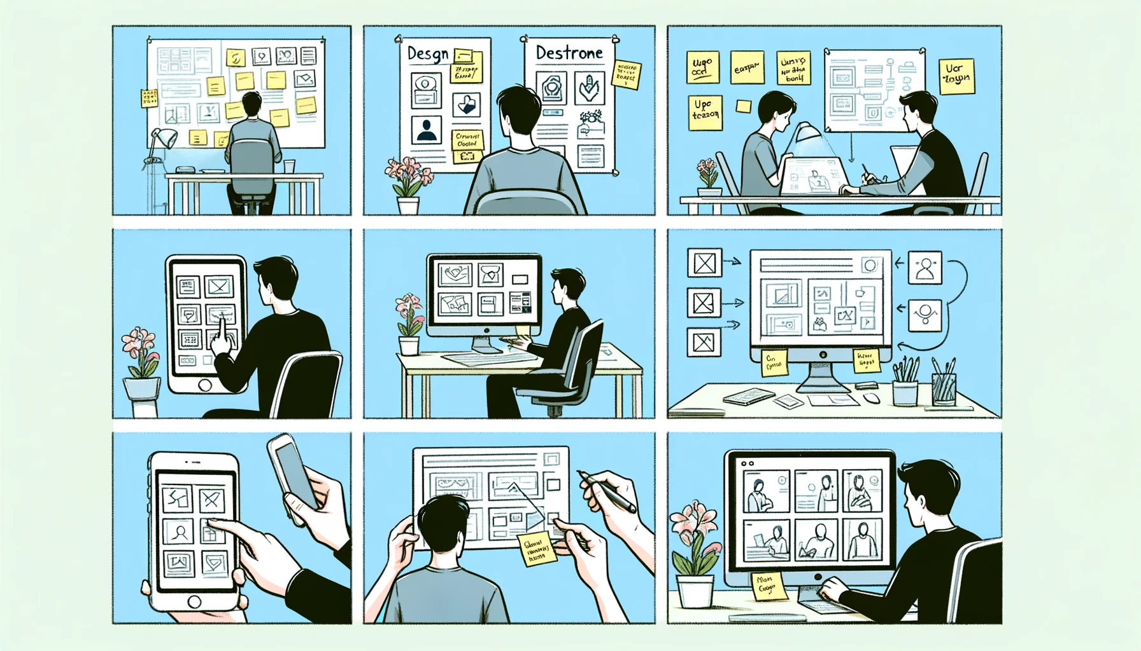

Slide 54
Wireframes
A wireframe is a visual representation or blueprint of a webpage, application, or user interface (UI) design. It is a simplified, skeletal outline that focuses on the layout, structure, and placement of elements without including detailed visual design elements such as colors, fonts, or images. Wireframes serve as a fundamental step in the design process, helping designers and stakeholders to:

Slide 55
Plan Layout: Wireframes provide a clear layout of where various UI elements will be placed on a screen. This helps in organizing content and functionality effectively.
User Flow: They help in defining the flow of user interactions and navigation within an application or website, showing how users move from one screen or page to another.
Functionality: Wireframes highlight the key functionality and features that need to be included in a design, allowing for better planning and prioritization.
Feedback and Collaboration: Wireframes are often used to gather feedback from stakeholders, team members, or clients early in the design process. This feedback can be used to refine and improve the design before moving on to more detailed design stages.

Slide 56
Wireframes can be created using various tools, including pen and paper, digital sketching software, wireframing tools like Balsamiq, Adobe XD, Sketch, Figma, or even simple drawing applications.
They come in different levels of fidelity, from low-fidelity (simple sketches) to high-fidelity (more detailed and closer to the final design). The choice of fidelity depends on the project's stage and the specific goals of creating the wireframe.
Overall, wireframes play a crucial role in the design and development of digital products by providing a visual guide for the user experience and interface design, helping teams and stakeholders align on design decisions and ensuring a smoother development process.

Slide 57
